Slide 1
Software Engineering
Fast-nu

Slide 2
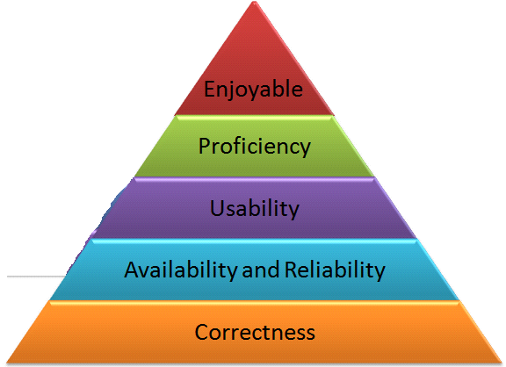

Agenda – What will you Learn Today?
What is Software Architecture?
Architecture Attributes

Slide 3
Software Architecture

Slide 4
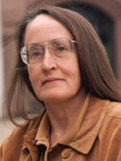

What is Software Architecture?
The Software Architecture of a system consists
of a description of
the system the system
elements, elements,
interactions between
patterns that guide the system elements and
constraints on the system elements.
relationships between
[Shaw and Garlan]
Carnegie Mellon University

Slide 5
What is Software Architecture?
The software
architecture of a
program or
computing system is the structure or structures
of the system,
which
comprise software
components, the externally visible properties of
those components, among them.
and the relationships
[SEI]

Slide 6
What is Software Architecture?
Architectural design: The process of defining a
collection of hardware and
software to establish
components and their interfaces
the framework for the computer system.
development of a
[IEEE Glossary]

Slide 7

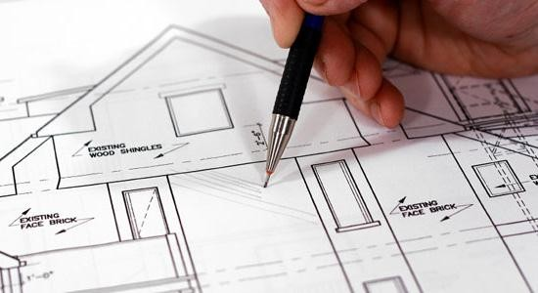

Importance of Architecture
Communication between stakeholders
A high-level presentation of the system
Use for understanding, negotiation and communication
Early design decisions
Profound effect on the systems quality attributes, e.g. performance, availability, maintainability etc.
Large-scale reuse
If similar system have common requirements, modules
can be identified and reused

Slide 8
Architecture Attributes

Slide 9
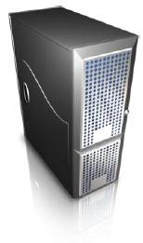
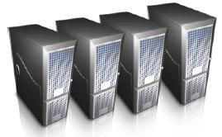
Performance
Localize the operations to minimize subsystem communication
Scale up …
Scale out …

Slide 10
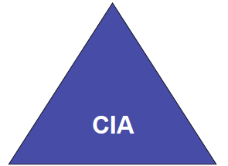
Security
Use a layered architecture with critical assets in inner layers
Confidentiality
Only authorized users can read the information
E.g. Military
Availability
Integrity
Only authorized users can modify, edit or delete data.
E.g. bank systems
Right information is available at the right time
Important for everyone

Slide 11

Safety
Isolate safe-critical components
The Whole System
Critical
Design so that all safety critical operations are located in one or few modules / subsystems.
Notes:
Security refers to a man made situation while safety refers to a nature based situation.
Safety means no harm is caused, deliberately or not. Security means that no deliberate harm is caused.

Slide 12
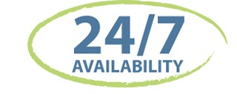
Availability
Include redundant components in the architecture
Notes:
Redundancy means having extra or duplicate resources available to support the main system. It is a backup or reserve system that can step in if the primary system fails.

Slide 13
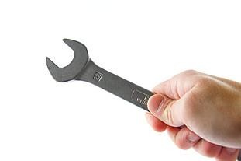
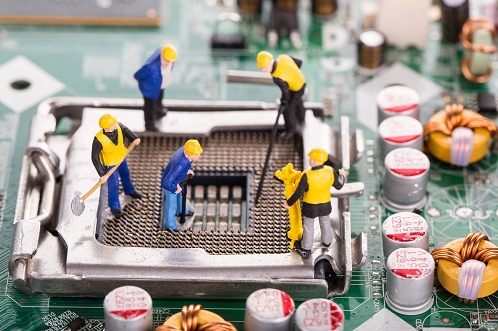
Maintainability
Use fine-grain, self-contained components

Slide 14
System structuring and Design Process
System structuring
Concerned with decomposing the system into interacting sub-systems
The architectural design is normally expressed as a block diagram presenting an overview of the system structure
More specific models showing how sub-systems share data, are distributed and interface with each other may also be developed
Modular decomposition
The identified sub-system are decomposed into modules.

Slide 15

Unified Modeling Language

Slide 16
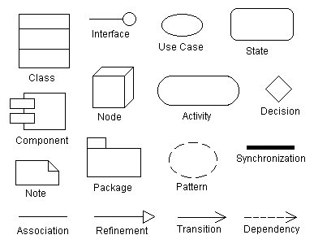
UML for Software Architecture
The Unified Modeling Language (UML) is a graphical language for
visualizing (pictorially connected components )
specifying,
constructing, and
documenting
the artifacts of a software-intensive system.
UML offers a standard way to draw a system's blueprints.
Same notation for every project

Slide 17
Architecture View Models
A model is a complete, simplified description of a system from a particular perspective or viewpoint.
There is no single view that can present all aspects of complex software to stakeholders!!!

Slide 18
View Model
View models provide partial representations of the software architecture to specific stakeholders such as
the system users,
the analyst/designer,
the developer/programmer,
the system integrator, and
the system engineer.

Slide 19
View Model
Software designers can organize the description of their architecture decisions in different views.

Slide 20
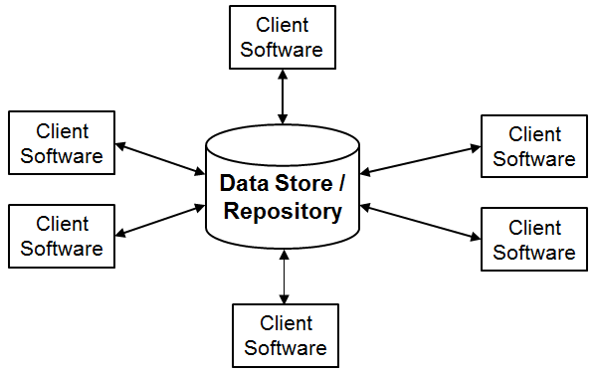
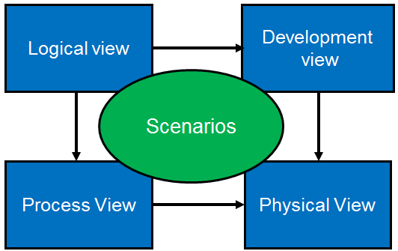
Krutchen’s 4+1 View Model of Software Architecture
Architecture Styles
Notes:
Krutchen’s 4+1 model helps plan software by considering multiple perspectives, while architecture styles define how system components communicate.

Slide 21
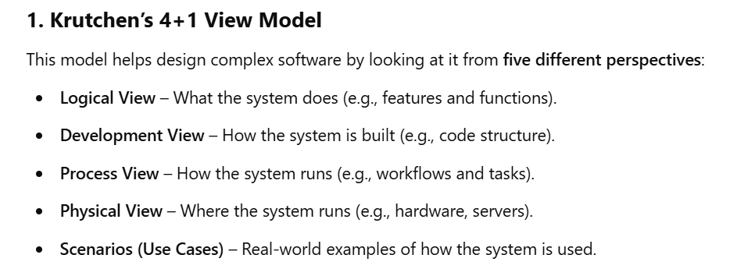

Slide 22
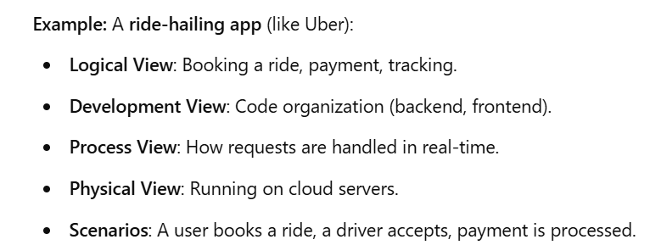

Slide 23
Krutchen’s 4+1 View Model

Slide 24
The 4 +1 View Model
The 4+1 view model was originally introduced by Philippe Kruchten (Kruchten, 1995).
The model provides four essential views:
the logical view,
the process view,
the physical view, and
the development view
and fifth is the scenario view

Slide 25
The 4+1 view model
Multiple-view model that addresses different aspects and concerns of the system. Standardizes the software design documents and makes the design easy to understand by all stakeholders.

Slide 26
The Scenario View
The scenario view describes the functionality of the system, i.e., how the user employs the system and how the system provides services to the users.
It helps designers to discover architecture elements during the design process and to validate the architecture design afterward.
The UML use case diagram and other verbal documents

Slide 27
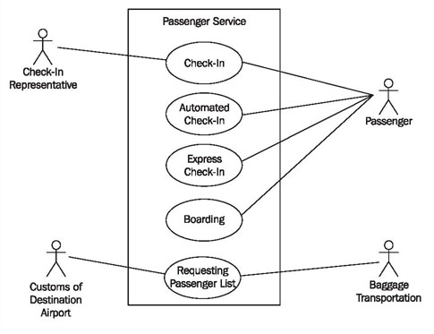

Slide 28
The Logical or Conceptual View
The logical view is based on application domain entities necessary to implement the functional requirements.
The logical view specifies system decomposition into conceptual entities (such as objects) and connections between them (such as associations).

Slide 29
The logical view
The logical view is typically supported by
UML static diagrams including class diagrams and state diagram.

Slide 30
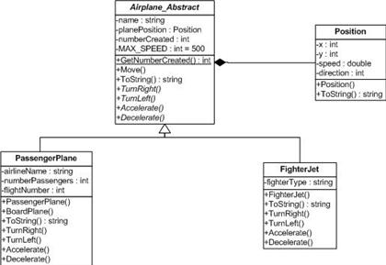

Slide 31
The Development or Module View
The development view derives from the logical view and describes the static organization of the system modules.
Modules such as namespaces, class library, subsystem, or packages are building blocks that group classes for further development and implementation.
UML diagrams such as package diagrams and component diagrams are often used to support this view.

Slide 32
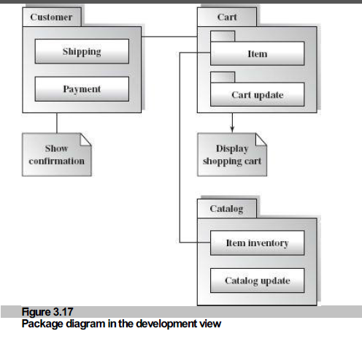
Show static behavior

Slide 33
The Process View
The process view focuses on the dynamic aspects of the system, i.e., its execution time behavior.
This view maps functions, activities, and interactions onto runtime implementation.
The process view takes care of the concurrency and synchronization issues between subsystems.
UML dynamic diagrams such as the interaction overview diagram, sequence diagram, communication diagram, activity diagram.

Slide 34
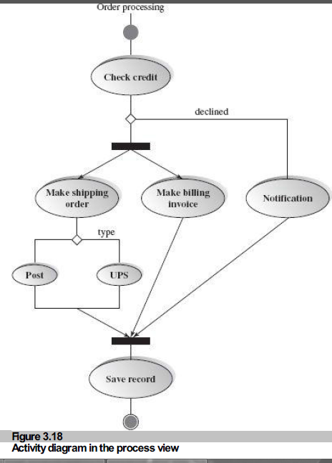

Slide 35
The Physical View
The physical view describes installation, configuration, and deployment of the software application.
It concerns itself with how to deliver the deploy-able system.
The physical view shows the mapping of software onto hardware.
It is particularly of interest in distributed or parallel systems.
The UML deployment diagrams and other documentation are often used to support this view.

Slide 36
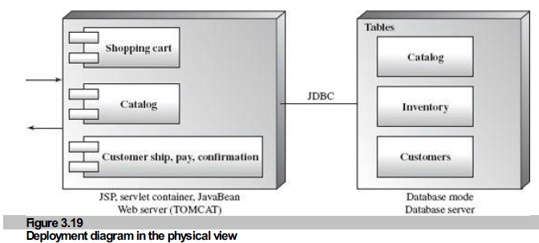

Slide 37
The User Interface View
The User Interface (UI) view is an extended view that provides a clear user-computer interface view and hides implementation details.
This view may be provided as a series of screen snapshots or a dynamic, interactive prototype demo.
Any modification on this view will have direct impact on the scenarios view.

Slide 38
Architectural Styles

Slide 39
Architectural Styles
The architectural model of a system may conform to a generic architectural model or style
An awareness of these styles can simplify the problem of defining system architectures

Slide 40
Architectural Styles (cont.)
Each style describes a system category that encompasses:
A set of components (e.g. database, computational modules) that perform a function required by a system
A set of connectors that enable “communication, coordination and cooperation” among components
Constraints that define how components can be integrated to form the system

Slide 41
Recap
What is Software Architecture?
Architecture Attributes

